Slide 1
Fluentd meets Unicode Windows EventLog
Fluentd meetup 2019
ClearCode Inc.
Hiroshi Hatake
Notes:
My name is Hiroshi Hatake.
Working at ClearCode Inc(operated) as a software developer.
Now, OK. Today, I'm gonna talk about "Fluentd meets Unicode Windows EventLog".
---
Before starting this talk, would you please raise your hand whose use Fluentd on Windows right now?
OK, Windows is (minor|normal|major) platform for using Fluentd in this room.
Please put your hand down.
And Fluentd people would you please raise your hand?
Hmm, Fluentd is major middleware in this room. Thanks.
Please put your hand down again.

Slide 2
Agenda
Motivation
About winevt_c
Unicode Character handling
Using ANSI code page issues
Unicode Testing
Benchmark
Throughput Benchmark
Conclusion
Notes:
So, here is today’s my talk agenda.
First, I'll talk about motivation.
Then, I'll talk about winevt_c which is the newly created gem shortly, Unicode character handling, using ANSI code page issues, Unicode testing, benchmark, throughput benchmark, and conclusion.

Slide 3
Agenda
Motivation
About winevt_c
Unicode Character handling
Using ANSI code page issues
Unicode Testing
Benchmark
Throughput Benchmark
Conclusion
Notes:
Now, let's start to talk about motivation.

Slide 4
Motivation
in_windows_eventlog has some issues...
😰Unicode character handling. Sometimes garbage chracters are generated.
😥Memory consumption in flood of windows event
😨Sometimes it causes SEGV
😅CPU spike when resuming operation
😱At least one event should exist in the listening channel on starting to listen. Otherwise, nothing to be read
And they are caused by dependent gem which is named win32-eventlog
Notes:
in_windows_eventlog which is the old plugin has some issues.
1st. Unicode character handling. Sometimes garbage characters are generated.
2nd. Memory consumption in flood of windows event
3rd. Sometimes it causes segmentation fault
4th. CPU spike when resuming operation
5th. At least one event should exist in the listening channel on start to listen. Otherwise, nothing to be read(red).
They are caused by dependent gem which is named win thirty two-eventlog.

Slide 5
Next Topic
Motivation
About winevt_c
Unicode Character handling
Using ANSI code page issues
Unicode Testing
Benchmark
Throughput Benchmark
Conclusion
Notes:
Next, I'm talking about winevt_c.
This gem is a solution for Unicode handling issue, but this issue is very complicated. I’ll describe it later.

Slide 6
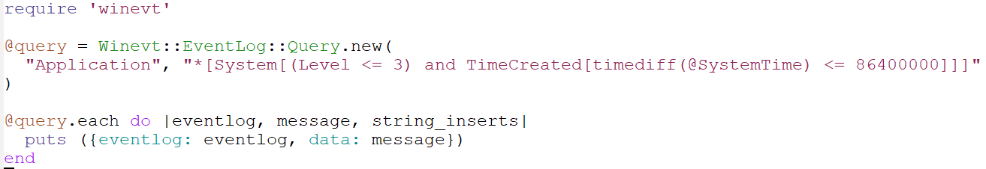
winevt_c (new gem): Code examples
Just querying for specified channel
Notes:
Then, I show you some winevt_c itself code examples.
First, this code is querying for specified channel.
In this case, specified channel is application.

Slide 7
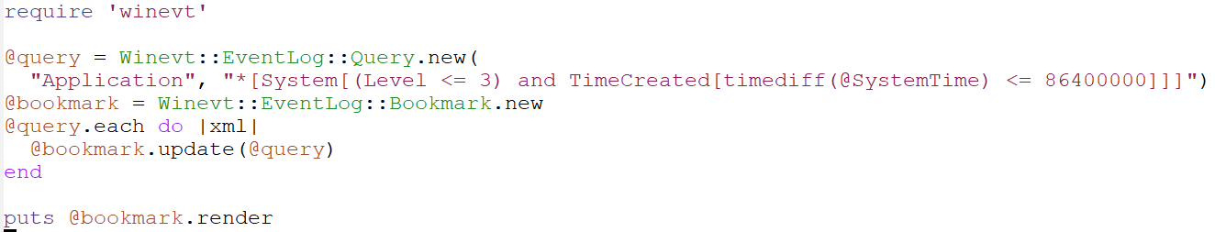
winevt_c (new gem): Code examples
Update bookmark for querying channel
Notes:
Second, displayed example code is updating bookmark for querying channel.
Bookmark is useful to resume operation.

Slide 8
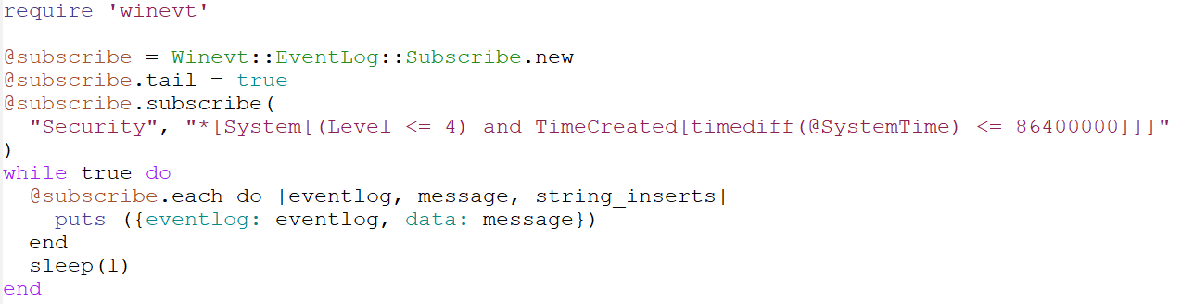
winevt_c (new gem): Code examples
Subscribe channel
Notes:
Third, the example code subscribes specified channel.
Subscribe API is battery included.
This API is useful for most users.

Slide 9
winevt_c (new gem)
It solves win32-eventlog issues
😊Improve Unicode character handling.
😋It doesn’t cause SEGV on the same situation
😃CPU spike when resuming operation is declined
😗Reduce memory consumption in flood of windows event
This issue still exists but it is reduced memory consumption
😁At least one event should exist in the listening channel on starting to listen.
Empty channel can also subscribe. The older one will be staled.
Notes:
The new gem which is named winevt_c solves win thirty-two-eventlog issues
1st. Improve Unicode character handling
2nd. It doesn’t cause segmentation fault on the same situation
3rd. CPU spike when resuming operation is declined
4th. Reduce Memory consumption in flood of windows event. This issue is partially solved but declined consuming memory.
5th. At least one event should exist in the listening channel on starting to listen. Empty channel can also subscribe. The older one will be staled.
1st Issue is the hardest problem and the others are solved by new API to read Windows EventLog.

Slide 10
winevt_c (new gem) The relationship of plugins and gems in this talk
In_windows_eventlog
In_windows_eventlog2
win32-eventlog
winevt_c
Notes:
The relationship of plugins and gems in this talk.
The old plugin which is named in_windows_eventlog depends on win32-eventlog.
And
The new plugin which is named in_windows_eventlog2 depends on winevt_c gem which is the newly created one.

Slide 11
Next Topic
Motivation
About winevt_c
Unicode Character handling
Using ANSI code page issues
Unicode Testing
Benchmark
Throughput Benchmark
Conclusion
Notes:
Next, Unicode character handling.
This part and the next part treat the hardest issues in this talk.

Slide 12
Unicode Character handling
What is Unicode?
In Windows context, it means UTF-16.
In Ruby C extension context, it means UTF-8.
Notes:
Then, we should consider what Unicode means.
WHAT IS UNICODE?
In Windows context, it means UTF-sixteen.
Ruby also can handle UTF-sixteen in Ruby code world, although we'll consider Ruby C extension.
Ruby C extension API does not provide convenient API to handle UTF-sixteen.
Thus, we should say: In Ruby C extension context, it means UTF-8.

Slide 13
Unicode Character handling: What is the difference between ANSI and Unicode?
In Windows, ANSI means current code page
In Japanese Edition Windows, it is CP932 (Windows-31J).
-A suffixed API uses ANSI character encoding
In Windows, Unicode means UTF-16
-W suffixed API uses UTF-16 character encoding
PWSTR and such W contained typed API arguments also use UTF-16 character encoding
Notes:
What is the difference between ANSI and Unicode?
In Windows, ANSI means current code page.
In Japanese edition Windows, it's code page nine-hundred thirty-two.
Large A suffixed API uses ANSI character encoding.
In Windows, Unicode means UTF-sixteen.
Large W suffixed API uses UTF-sixteen character encoding.
PWSTR and such Large W contained type API arguments also use UTF-sixteen character encoding.

Slide 14
Unicode Character handling
We need to convert from UTF-16 to target character encoding
In this case, target encoding is UTF-8
But, win32-eventlog gem uses OpenEventLogA, ReadEventLogA (ANSI version)
To handle Unicode characters correctly, we need to use OpenEventLogW, ReadEventLogW (Unicode version)
win32-eventlog gem development is inactive in recent days.
Unicode version patch exists, but it have not been merged in....
Notes:
So, we need to convert from UTF-sixteen to UTF-8 as described before.
The win thirty-two eventlog uses ANSI version of Windows API.
To handle Unicode characters correctly in win thirty-two eventlog, we need to use Unicode version of them.
In addition, win thirty-two eventlog gem development is inactive in recent days.
And Unicode version patch exists, but it have not been merged in.

Slide 15
Next Topic
Motivation
About winevt_c
Unicode Character handling
Using ANSI code page issues
Unicode Testing
Benchmark
Throughput Benchmark
Conclusion
Notes:
Then, next topic is Using ANSI code page issues.

Slide 16
Using ANSI code page issues
On Japanese Edition Windows' default code page can handle...
Alphabets
Greek letters
Cyrillic alphabets
Hiragana, Katakana
JIS level 1 and 2 Kanji sets (Chinese Characters)
But other characters cannot handle with cp932 (In Japanese Edition Windows)
Notes:
ANSI code page is lightweight encoding way for specific characters, but it causes encoding issue in some cases.
In Japanese Edition Windows, it uses code page nine-hundred thirty-two by default.
It can handle
* Alphabets
* Greek letters
* Cyrillic alphabets
* Hiragana and Katakana
* JIS level one and two Kanji Sets
Other characters cannot handle with code page nine-hundred thirty-two.

Slide 17
Using ANSI code page issues: UTF-8 contains more characters!
UTF-8 can also handles...
Alphabets
Greek letters
Cyrillic alphabets
Hiragana, Katakana
JIS level 1 and 2 Kanji set (Chinese Characters)
And...
diacritical mark (such as umlaut in German: ä, ö, ü)
Hebrew, Arabic, Devanagari (Hindi)
South East Asia Characters (Thai, Laotian... etc.)
And Emoji!! 😎
Notes:
UTF-8 contains more characters!
UTF-8 encoding can handle code page nine-hundred thirty-two characters and,
Diacritical mark such as umlaut in German
Hebrew, Arabic, Devanagari. Devanagari is the letters for Hindi.
South east asia characters such as Thai, Laotian... etsetra.
And Emoji characters.

Slide 18
Using ANSI code page issues: Solution
We decide to develop the brand new gem which is named winevt_c.
😍It uses new Windows API that is defined in <winevt.h>
😉The new API provides bookmark which is used to resume operation
😊Unicode API
But this gem is written in C and C++
😭Users need to build C/C++ extension code by themselves
😮Current RubyInstaller bundles MSYS2 system. Users can use gcc and g++ after MSYS2 installation which is kicked by RubyInstaller.
Notes:
So, we reached ANSI code page issues solution.
We decide to develop the brand-new gem which is named winevt_c.
1. It uses new Windows API that is defined in <winevt.h>
2. The new API provides bookmark which is used to resume operation
3. Unicode native API
This gem's detail was described in about winevt_c section.
This gem is written in C and C plus plus.
So, users need to build C and C plus plus extension code by themselves.
Current RubyInstaller bundles MSYS2 system. We needn't worry about it more than necessary.

Slide 19
Next Topic
Motivation
About winevt_c
Unicode Character handling
Using ANSI code page issues
Unicode Testing
Benchmark
Throughput Benchmark
Conclusion
Notes:
The next topic is Unicode testing.

Slide 20



Unicode Testing: Environment
Windows 10 Home 1903 64bit
Japanese Edition (cp932, Windows-31J)
Writing Windows EventLog
Benchmark tool written in C#
Terminal:
PowerShell Core 6 on Windows Terminal(Preview)
Used Windows Terminal Profile is here
Notes:
In this section, I'm talking about Unicode testing.
This test environment is:
* Japanese edition Windows ten home nineteen-ow-three six-four bits
* Prepared writing Windows EventLog tool which is written in C-sharp
* And I used PowerShell Core six on Windows Terminal. Not command prompt and raw Powershell terminal.
'Cause command prompt and raw PowerShell terminal cannot display Thai, Devanagari, Emoji and so on.

Slide 21
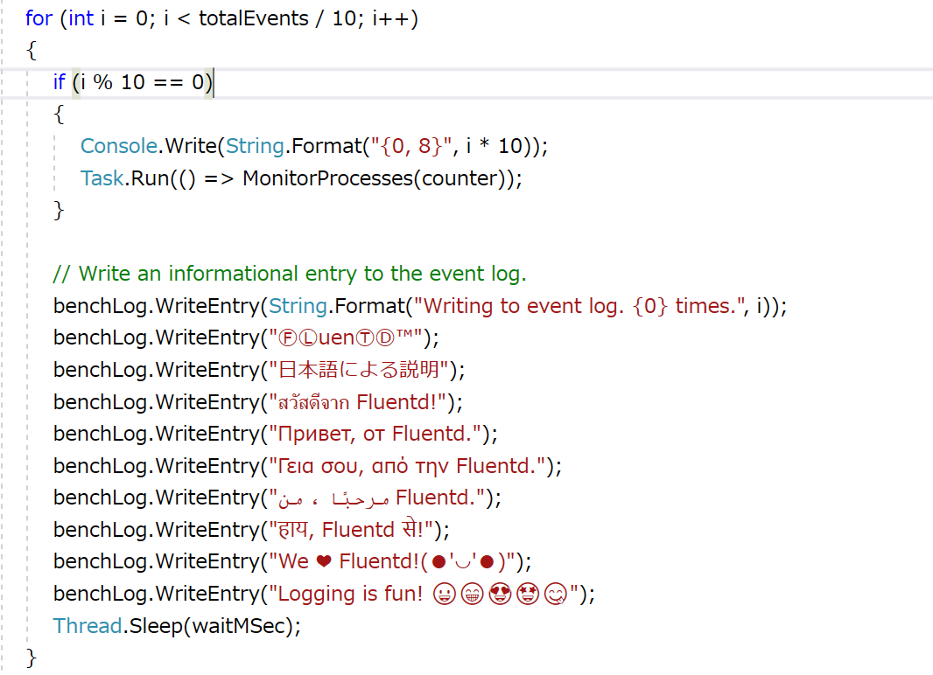
Unicode Testing: Writing Events in .NET (picked up)
// Alphabets
// Non-ASCII symbols
// Japanese
// Thai
// Cyrillic
// Greek letters
// Arabic alphabets
// Devanagari
// Unicod-ish Kaomoji
// Emoji
Notes:
Here is the snippet of writing Windows EventLog code that contains...
Alphabets
Non-ASCII symbols
Japanese
Thai
Cyrillic
Greek letters
Arabic alphabets
Devanagari
Unicod-ish Kaomoji
And Emoji

Slide 22
Unicode Testing: Writing Events
PS> EventLogbencher.exe -w 10 -t 10
10 Events Written into Benchmark channel
Notes:
Unicode testing uses benchmarking tool which is created for heavily loaded benchmark, but it accepts parameters for lightweight writing.
The shown command-line means ten events written into benchmark channel.
And sleep ten milliseconds before it displays flow rate.

Slide 23
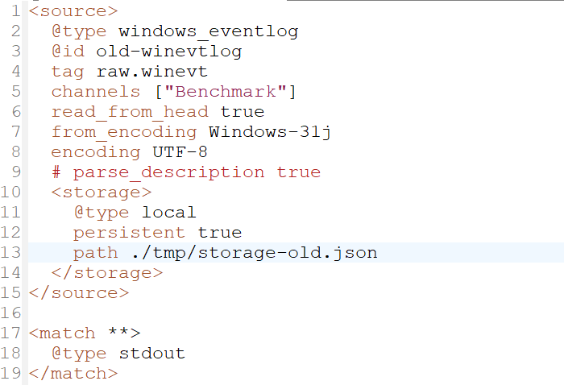
Unicode Testing: Configuration (old plugin)
from_encoding/encoding parameters are needed to handle character encoding correctly but still unhandled characters exist.
And using default read_interval: 2s.
Notes:
This slide and the next slide describe configuration for Unicode testing.
Fluentd will use in_windows_eventlog as a source and out_forward as an output.
Note that the old plugin requests to use from_encoding and encoding parameters to handle character encoding correctly.
And also default read_interval parameter which is two-seconds is used.
But still unhandled characters exist.

Slide 24
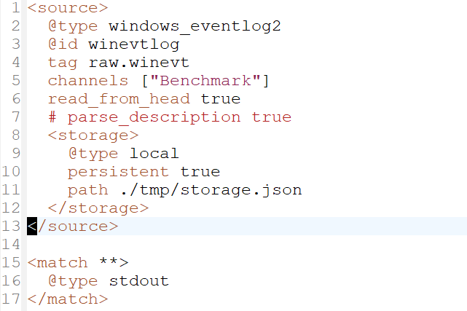
Unicode Testing: Configuration (new plugin)
No need to specify from_encoding/encoding parameters. And new plugin always handles character encoding as UTF-8.
And using default read_interval: 2s.
Notes:
Fluentd will use in_windows_eventlog2 as a source and out_forward as an output.
Note that the new plugin doesn't request to use from_encoding and encoding parameters.
And also default read_interval parameter which is two-seconds is used.
The new plugin always handles character encoding as UTF-8.
So, they needn't anymore!

Slide 25
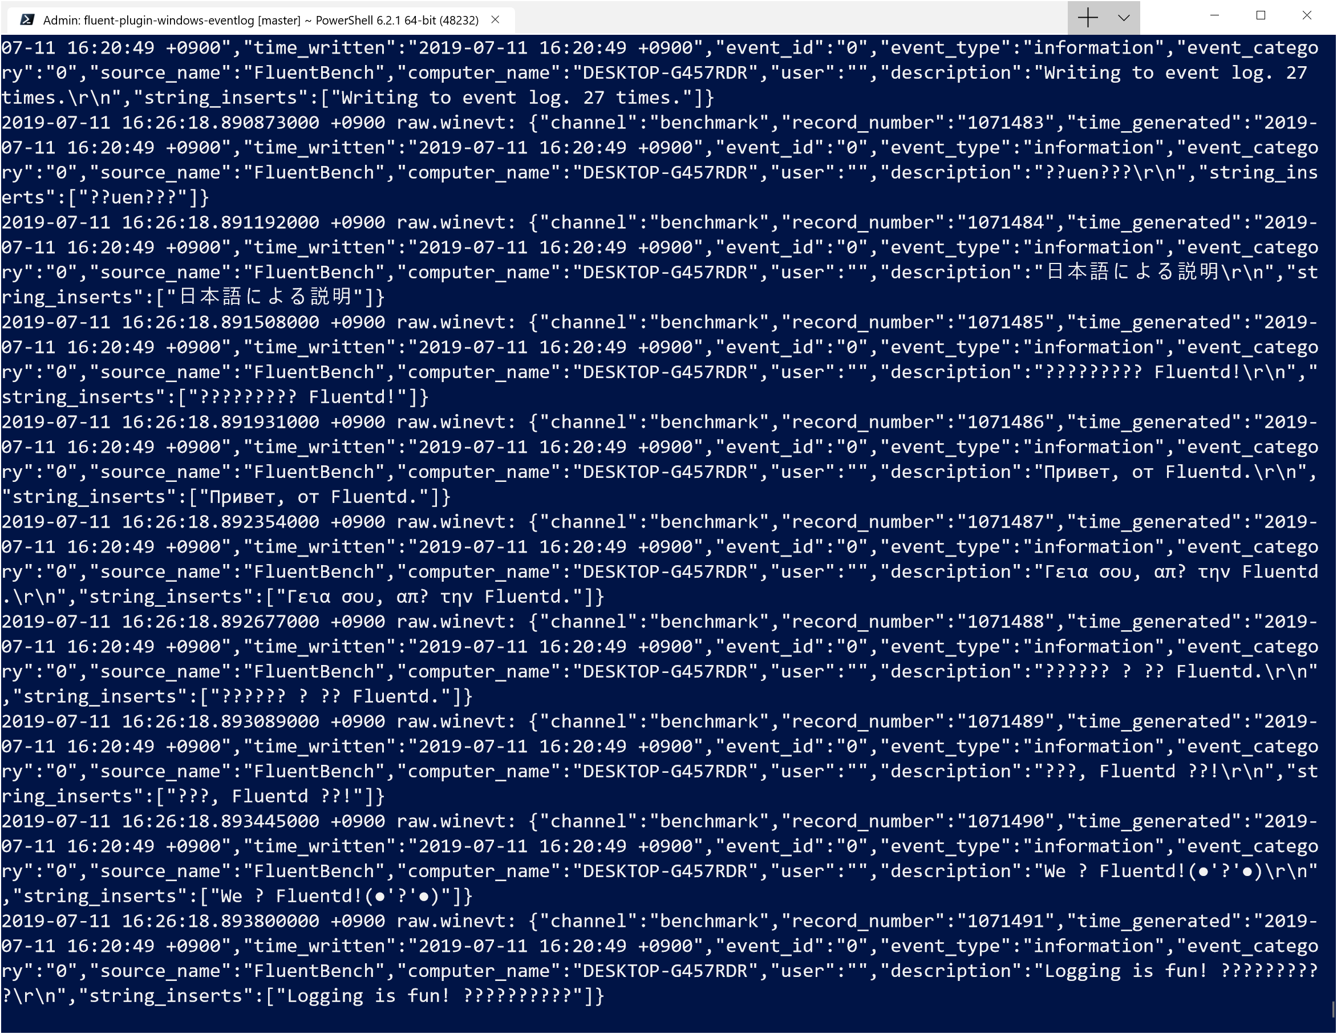






Unicode Testing: Execution Log (old plugin)
The following characters are broken
Symbol ⒻⓁⓉⒹ™​
Thai
Arabic
Devanagari (Hindi)
Unicode contained Kaomoji
Emoji
Notes:
Then, let's see the old plugin execution log.
Symbol, Thai, Arabic, Devanagari, Unicode contains Kaomoji, and Emoji are displayed broken.

Slide 26
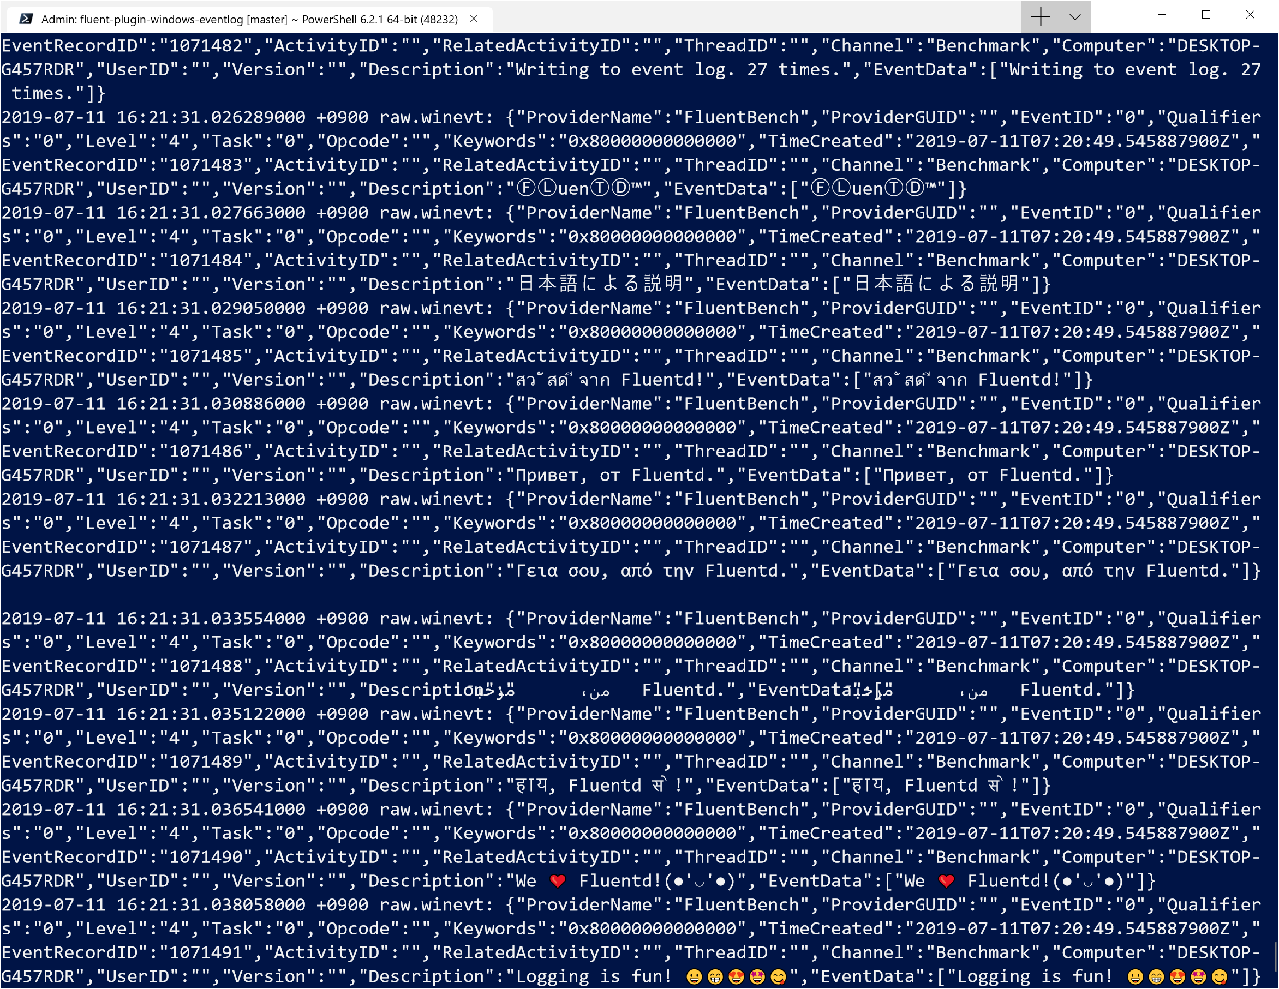

Unicode Testing: Execution Log (new plugin)
The following characters are rendered
Symbol ⒻⓁⓉⒹ™
Thai
Arabic (but slightly wrong rendered)
Devanagari (Hindi)
Unicode contained Kaomoji
Emoji
Notes:
The other result is the new plugin execution log.
It displays Symbol, Thai, Devanagari, Unicode contains Kaomoji, and Emoji are correctly displayed.
Arabic is slightly broken but it is Windows Terminal's displaying issue.
Now, we can handle Emoji characters contaminated Windows EventLog.

Slide 27
Next Topic
Motivation
About winevt_c
Unicode Character handling
Using ANSI code page issues
Unicode Testing
Benchmark
Throughput Benchmark
Conclusion
Notes:
So, we reached benchmark section.

Slide 28


Benchmark
Collector Node
Windows 10 1809 2 vCPU 4GB Standard SSD
Benchmark tool written in C#
Aggregator Node
Ubuntu 18.04 2 vCPU 4GB Standard SSD
They are also Azure instances
Write EventLog
Collector Node
Aggregator Node
Notes:
In this section, I'm talking about Benchmark.
Benchmark environment has two nodes:
The collector node is Windows ten eighteen-ow-nine and has two of virtual CPUs, four gigabytes memory and standard SSD.
The aggregator node is Ubuntu eighteen point zero-four and has two virtual CPUs, four gigabytes memory and standard SSD.
The collector Fluentd process and writing EventLog tool are running on the collector node.
And the aggregator Fluentd process is running on the aggregator node.
The collector Fluentd sends events with forward protocol and the aggregator Fluentd receives with the same protocol.

Slide 29
Benchmark: Flow Rate of Events
1000000 events total
About 91 events per seconds
PS> EventLogbencher.exe -w 100 -t 1000000
1 million Events Written into Benchmark channel
Notes:
1 million events will write into collector node by benchmarking tool.
Its flow rate is about ninety-one per seconds.
The shown command-line generates events and writing them into the benchmark channel.

Slide 30
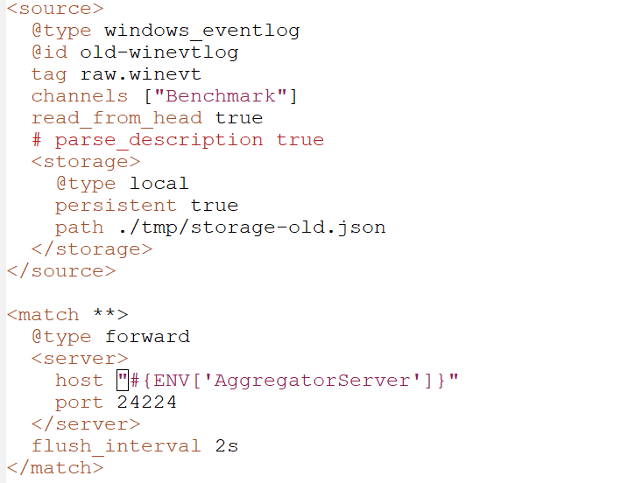
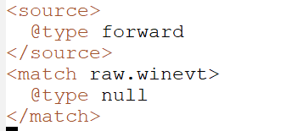
Benchmark: Configuration (old)
Collector node
Aggregator node
# or stdout
Notes:
The left side configuration is for the collector node.
In_windows_eventlog is used as a source and out_forward is used as an output.
The right side configuration is for the aggregator node.
It receives events from the collector Fluentd with forward protocol. Output is out_null or out_stdout.

Slide 31
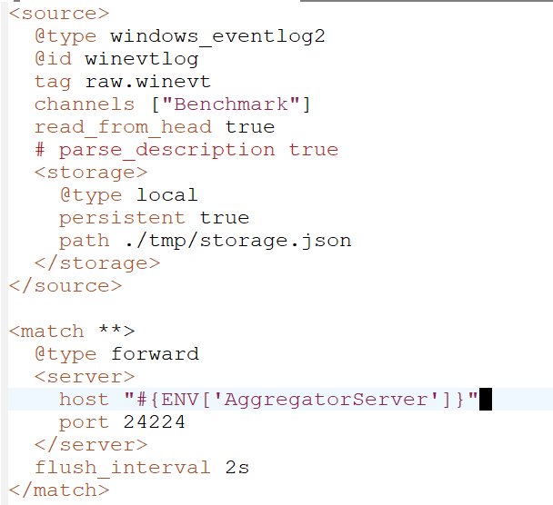
Benchmark: Configuration (new)
Collector node
Aggregator node
# or stdout
Notes:
The left side configuration is for the collector node.
In_windows_eventlog2 is used as a source and out_forward is used as an output.
The right side configuration is for the aggregator node.
It also receives events from collector Fluentd with forward protocol. Output is out_null or out_stdout.

Slide 32
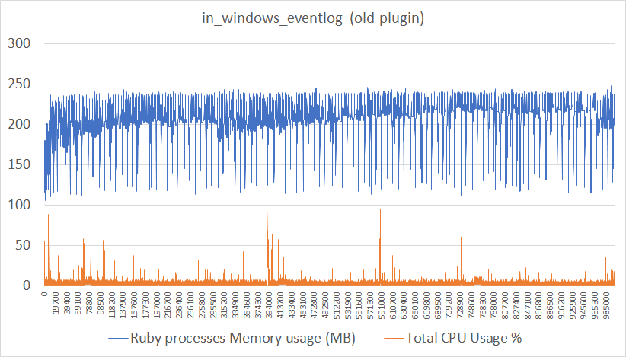
Benchmark (old plugin)
Flow rate: 91.34361 events per seconds
Notes:
Now, let's see the benchmarking results.
First, here is the old plugin benchmarking result.
This graph shows that the old plugin uses around between one-hundred ten and two-hundred forty megabytes memory.
And CPU usage sometimes spikes but around ten percent is used in the entire node.

Slide 33
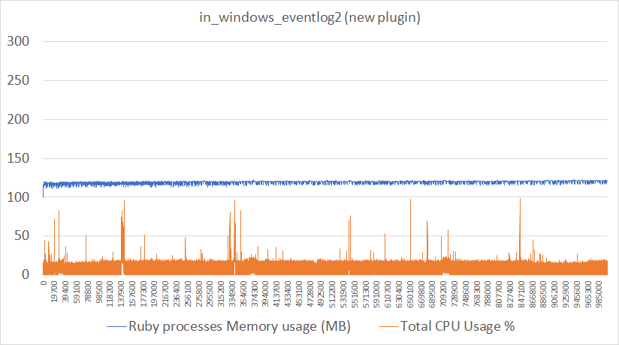
Benchmark (new plugin)
Flow rate: 91.30634 events per seconds
Notes:
Second, here is the new plugin benchmarking result.
This graph shows that the new plugin uses around one-hundred twenty megabytes memory.
But CPU usage slightly higher than the previous.

Slide 34
Benchmark Result: in_windows_eventlog
Pros
😀Low CPU usage
Cons
😣High memory usage
😫Incomplete Unicode handling
Notes:
Now, we can say pros and cons for the old plugin.
Pros:
* Low CPU usage
Cons:
* High memory usage
* And incomplete Unicode handling

Slide 35
Benchmark Result: in_windows_eventlog2
Pros
😀Low memory usage
😋Unicode handling
😊Immediately subscribe channel even if it's empty on subscribe
Cons
😣Slightly higher CPU usage rather than old plugin's
Notes:
Also, we can say pros and cons for the new plugin.
Pros:
* Low memory usage
* Unicode handling
* immediately subscribe channel event if it's empty on subscribe
Cons:
* Slightly higher CPU usage rather than the old plugin's

Slide 36
Next Topic
Motivation
About winevt_c
Unicode Character handling
Using ANSI code page issues
Unicode Testing
Benchmark
Throughput Benchmark
Conclusion
Notes:
The last topic is throughput benchmarking.

Slide 37
Throughput Benchmark
Collector Node
Windows 10 1809 2 vCPU 4GB Standard SSD
Benchmark tool written in C#
Aggregator Node
Ubuntu 18.04 2 vCPU 4GB Standard SSD
They are also Azure instances
Write EventLog
Collector Node
Aggregator Node
Notes:
In this section, I’m gonna talk about Throughput Benchmark.
Benchmark environment has two nodes:
The collector node and the aggregator node.
They are the same setup at Benchmarking test which is used in the previous section.

Slide 38
Throughput Benchmark
500000 events total
Increase flow rate of events step by step
PS> EventLogbencher.exe -w 50 -t 500000
159.4378 events per seconds
PS> EventLogbencher.exe -w 30 -t 500000
293.4133 events per seconds
PS> EventLogbencher.exe -w 20 -t 500000
314.823 events per seconds
PS> EventLogbencher.exe -w 15 -t 500000
321.7238 events per seconds
PS> EventLogbencher.exe -w 10 -t 500000
Stuck 🤢
598.8318 events per seconds
chunk bytes limit exceeds for an emitted event stream warning is generated from Fluentd....
Notes:
Throughput Benchmark setup is as follows:
Writing five-hundred-thousand events
Increase flow rate of events step by step
* around one-hundred-sixty events per second
* around two-hundred-ninety events per second
* around three-hundred-ten events per second
* around three-hundred-twenty events per second
* And the last case is stuck.
(Chunk bytes limit exceeds for an emitted event stream warning is generated from Fluentd...)

Slide 39
Throughput Benchmark: Configuration
Collector node
Aggregator node
# or stdout
Notes:
The left side configuration is for collector node.
In_windows_eventlog2 is used as a source and out_forward is used as an output.
The right side configuration is for the aggregator node.
This configuration is same as the previous benchmarking test.

Slide 40
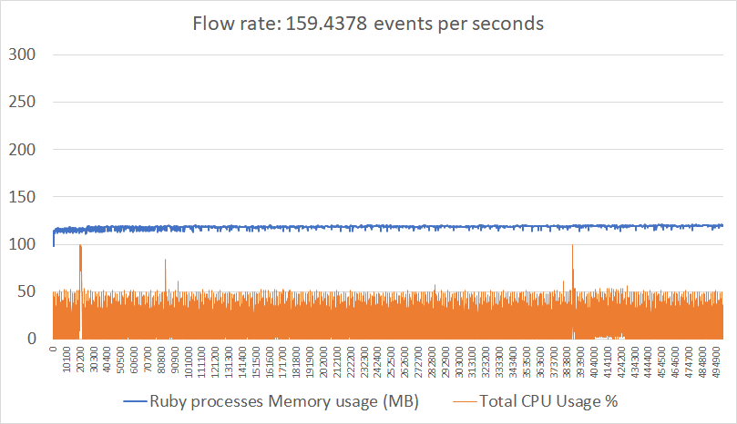
Throughput Benchmark: Result 1
Notes:
Here is around one-hundred-sixty events per second case. The new plugin can consume benchmark channel events.

Slide 41
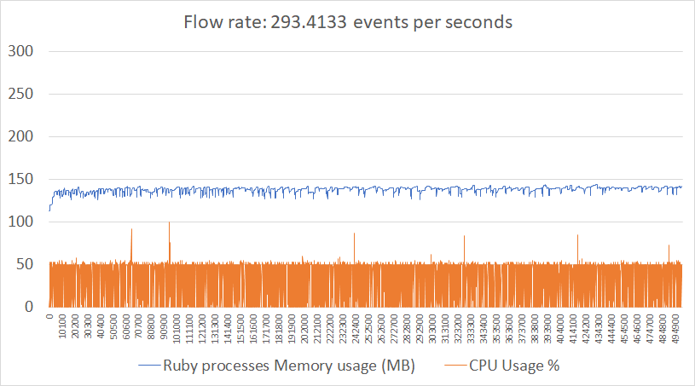
Throughput Benchmark: Result 2
Notes:
The next is around two-hundred-ninety events per second case. The new plugin also can consume benchmark channel events.

Slide 42
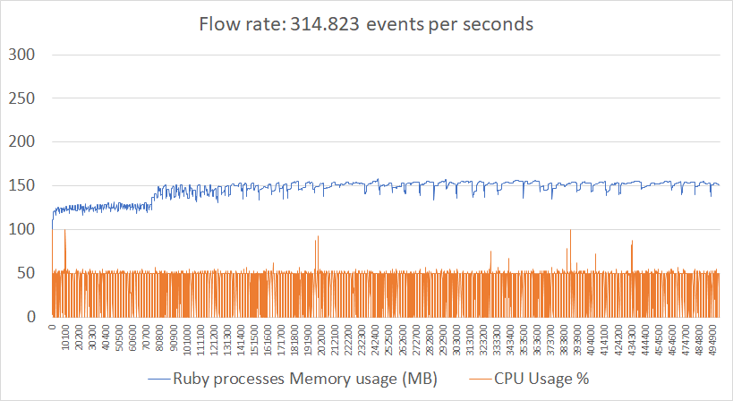
Throughput Benchmark: Result 3
Notes:
Third is around three-hundred-ten events per second case. The new plugin also can consume benchmark channel events.
But it is slightly growing up memory consumption.

Slide 43
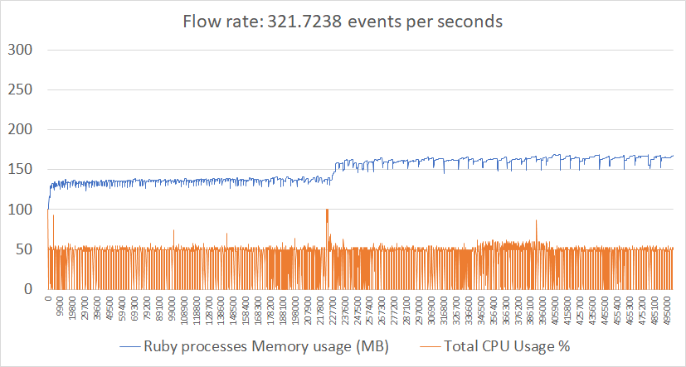
Throughput Benchmark: Result 4
Notes:
The last normal case is around three-hundred-twenty events per second case. The new plugin also can consume benchmark channel events.
But it is also slightly growing up memory consumption.

Slide 44
Conclusion
The new plugin which is named in_windows_eventlog2 does...
Improve Unicode handling
Reduce memory consumption
Solve CPU spike after resuming operation
The new plugin might be going to solve...
Slightly higher CPU usage than old plugin's
The new plugin can handle about 300 events per second with default read interval.
Notes:
Finally, here is the conclusion.
The new plugin which is named in_windows_eventlog2 does...
* Improve Unicode handling. Thanks to winevt_c gem!
* Reduce memory consumption
* Solve CPU spike after resuming operation
But still there is an issue in the new plugin:
* Slightly higher CPU usage than old one
From throughput benchmarking result, the new plugin can handle about three-hundred event per second with default read_interval parameter.

Slide 45
Epilogue: Current fluent-plugin-windows-eventlog status
The new plugin which is named in_windows_eventlog2
Included fluent-plugin-windows-eventlog v0.3.0
We want to hear more user voices and use cases
Installation is harder than the older one
Let's enjoy Monitoring Windows EventLog! 😁
Notes:
The new plugin which is named in_windows_eventlog2’s status is…
included fluent-plugin-windows-eventlog2 version zero-point-three-point-ow.
We wanna to hear more user voices and use cases
Note that Installation is a bit of harder than the older one
Let's enjoy Monitoring Windows EventLog!

Slide 46
Any Questions?
Notes:
Thank you for listening!
Any questions?

Slide 48
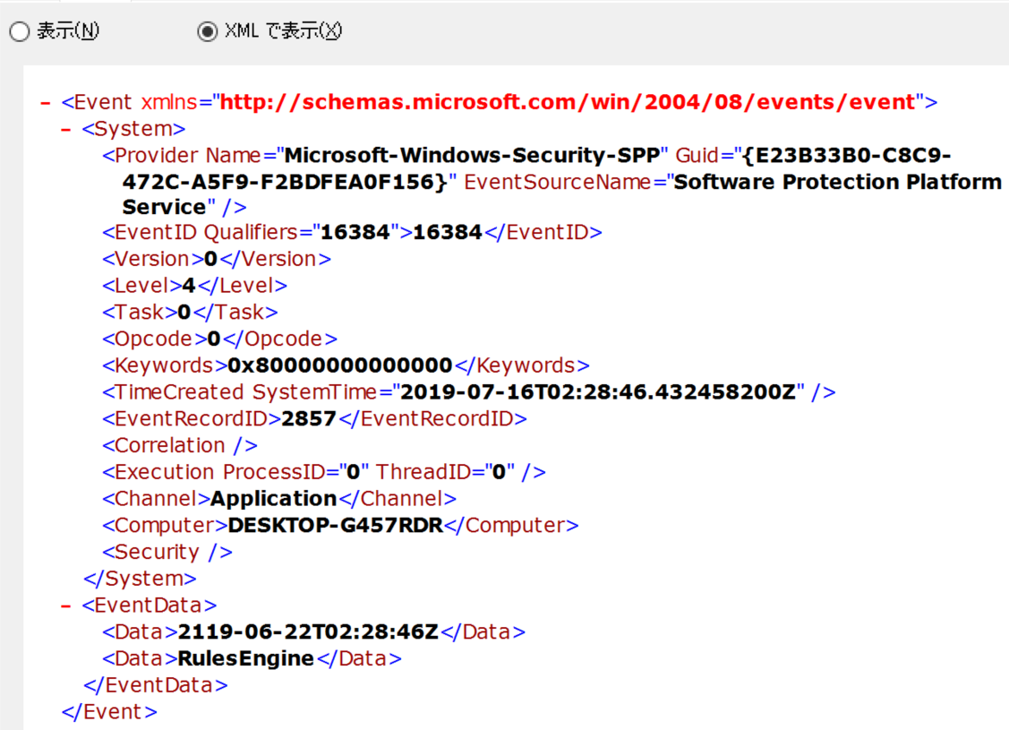
Windows EventLog structure
System
EventData/UserData
Notes:
Windows EventLog Structure is:
It contained two parts, System and EventData/UserData.
Win32-eventlog gem assumes the second part is always "EventData" which has flatten structure but also UserData should be put in.
The latter case, user data part has a bit more compilcated. I believe this causes segmentation fault on the old plugin.

Slide 49
Unicode Character Handling
We can use to convert encoding from UTF-16 to UTF-8 is:
WideCharToMultiByte
and when from UTF-8 to UTF-16:
MultiByteToWideChar
They are Windows API. We can use them to handle character encoding conversion.
Notes:
We can use to convert encoding from UTF-16 to UTF-8 is:
WideCharToMultiByte
and when from UTF-8 to UTF-16:
MultiByteToWideChar
They are Windows API. We can use them to handle character encoding conversion.
And They are also used in winevt_c gem.

